Slide 1
Lab Oriented Project (CS183)
Project Title:
Art&Craft – Art&Craft Supplies eCommerce Platform
Group Members:
Rudar Attri – 2211981320
Rudar Pratap Singh – 2211981321
Shaiv Sud – 2211981358
Sharad Chandel-2211981360
Department:
Computer Science and Engineering, Chitkara University, Himachal Pradesh

Slide 2





Technology Stack
Frontend: React, Tailwind CSS
Backend: Node.js , Express.js
Database: MongoDB
Authentication: JWT
File Handling: Multer(For File Upload)

Slide 3
Project Abstract
A full-stack MERN eCommerce app for browsing, managing, and ordering Art & Craft supplies. Admins control the store, users enjoy the shopping. Key Features:
JWT-based secure authentication
Admin dashboard for full product & order control
Image upload support using Multer
Secure token-based authentication
Floating AI Chatbot Support

Slide 4
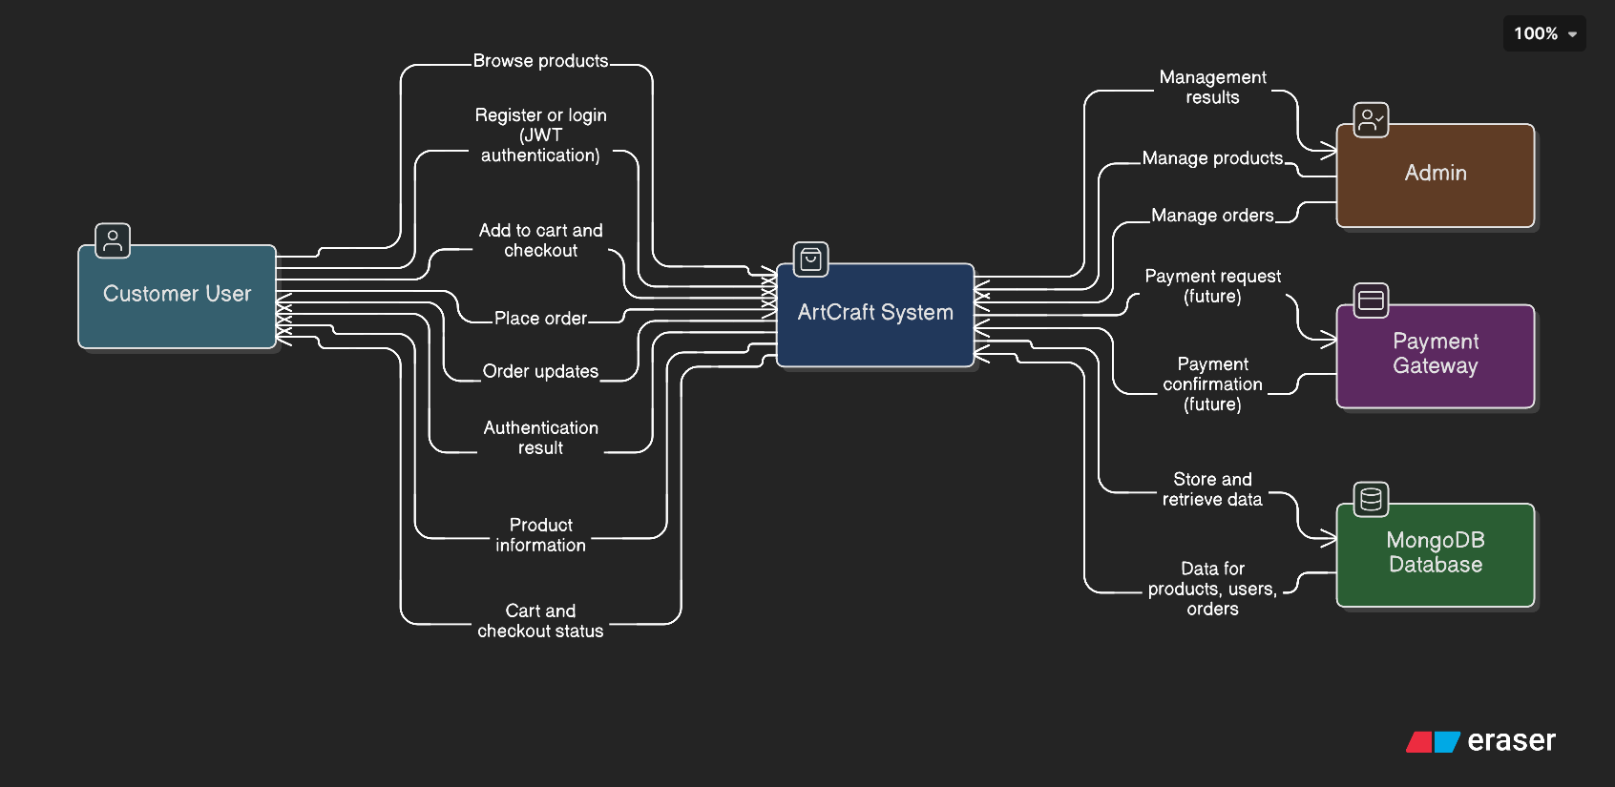
Context Diagram

Slide 5
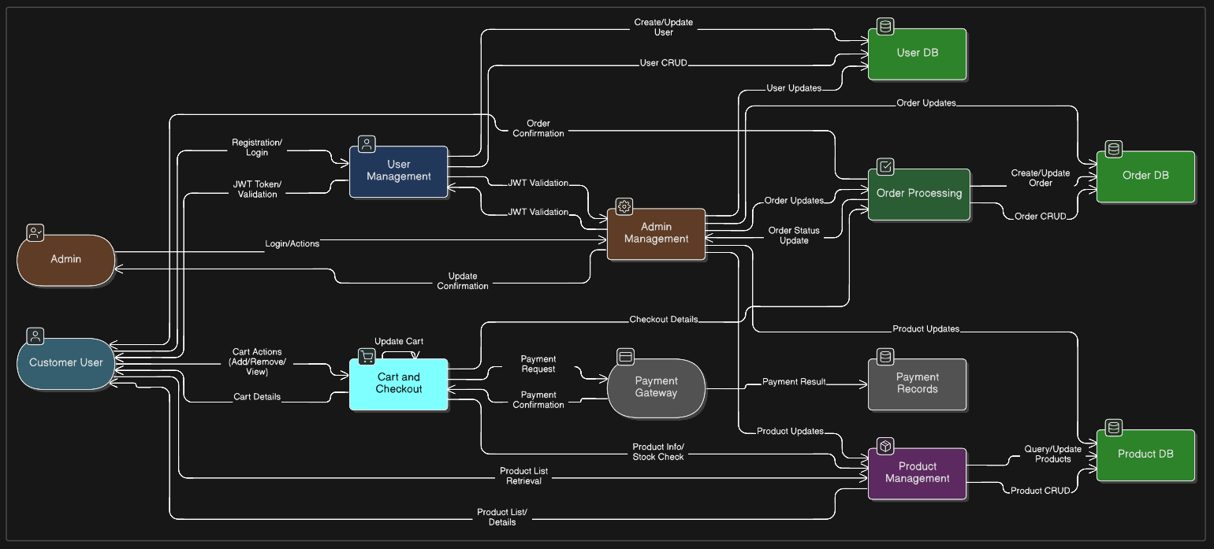
DFD L1 Diagram

Slide 6
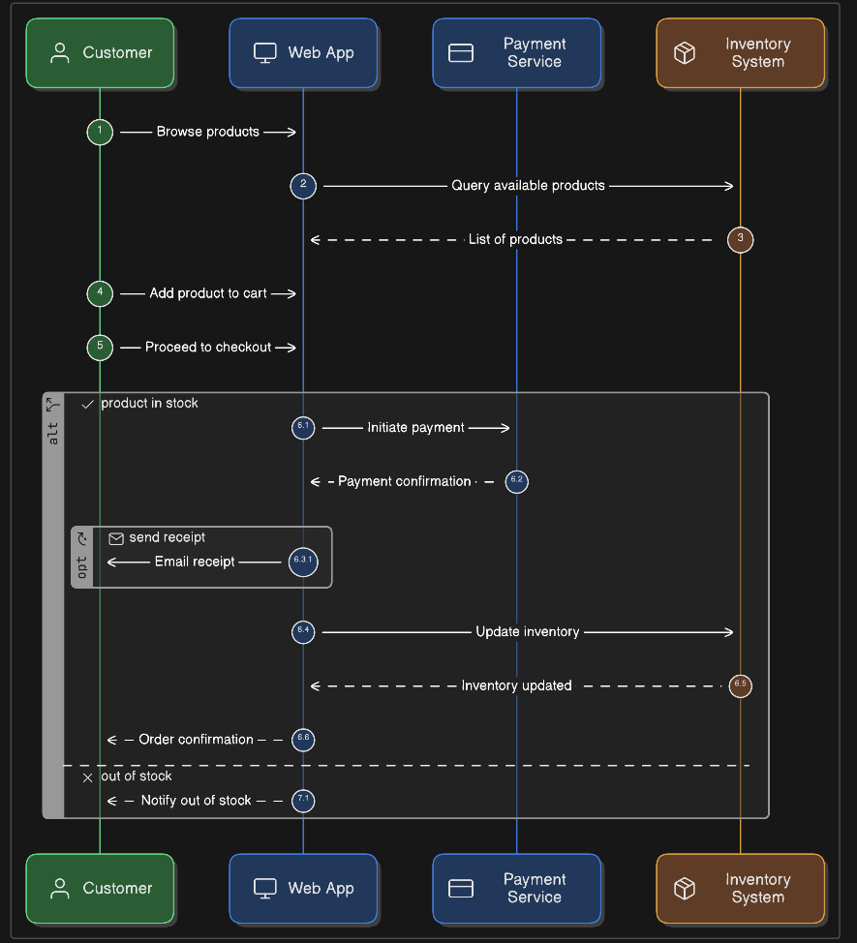
Sequence Diagram

Slide 7
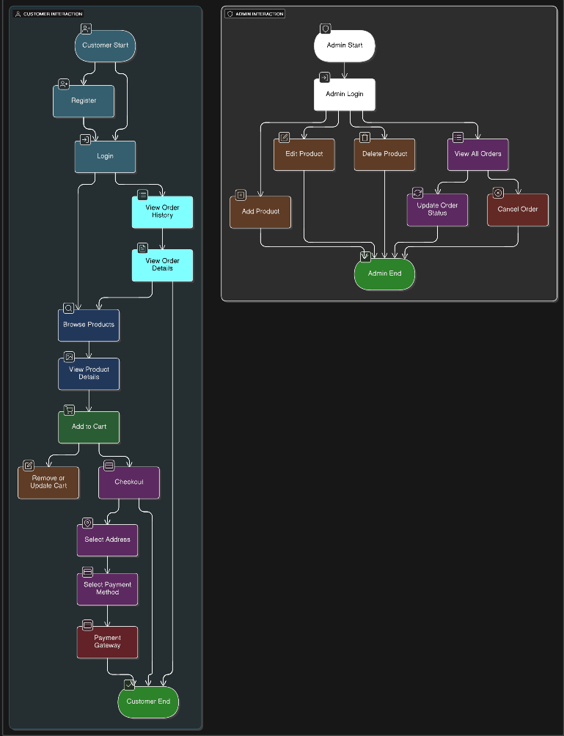
Flow Diagram

Slide 8
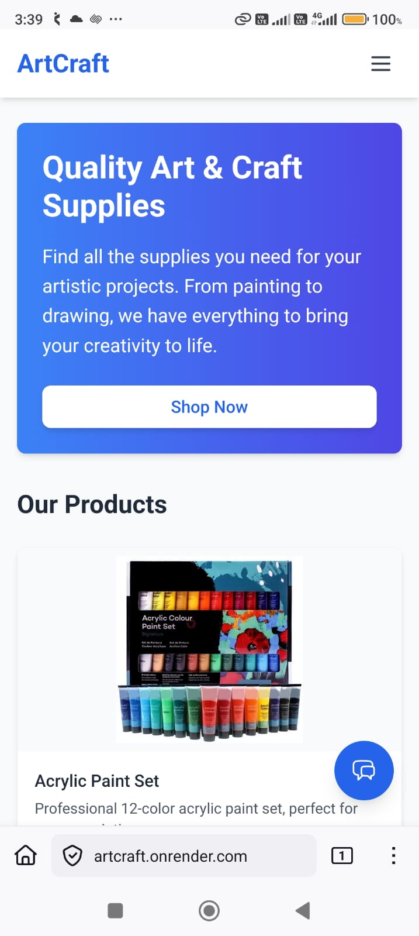
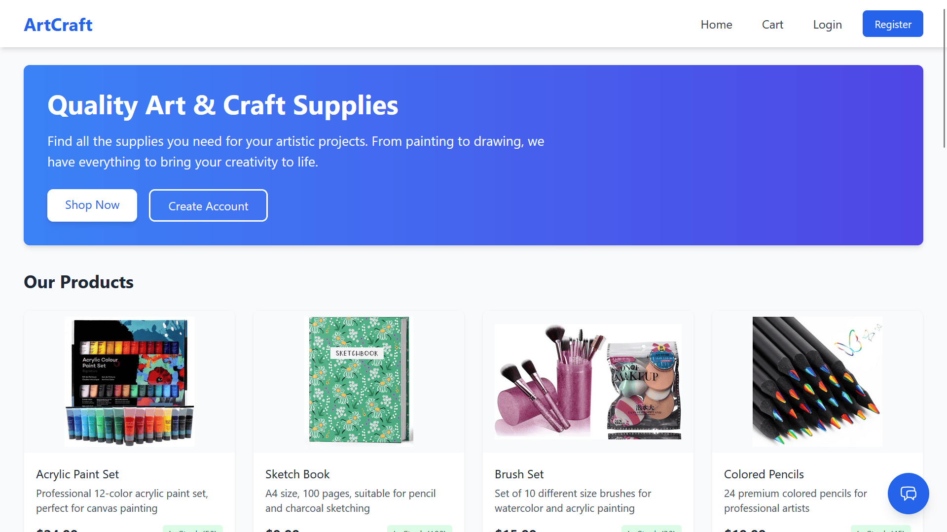
Home

Slide 9
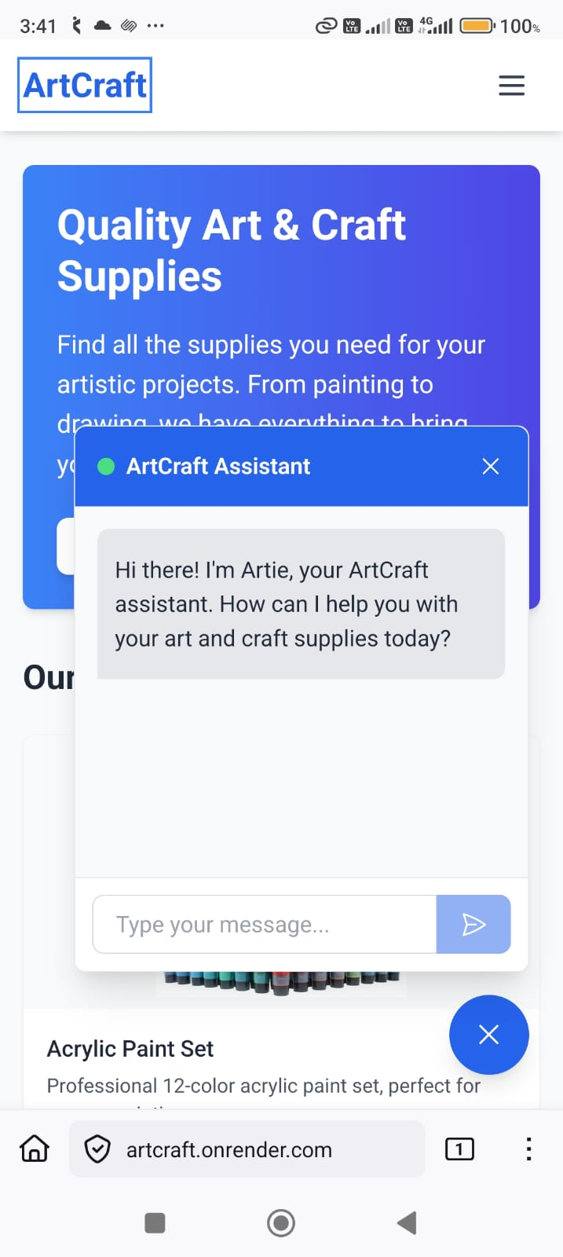
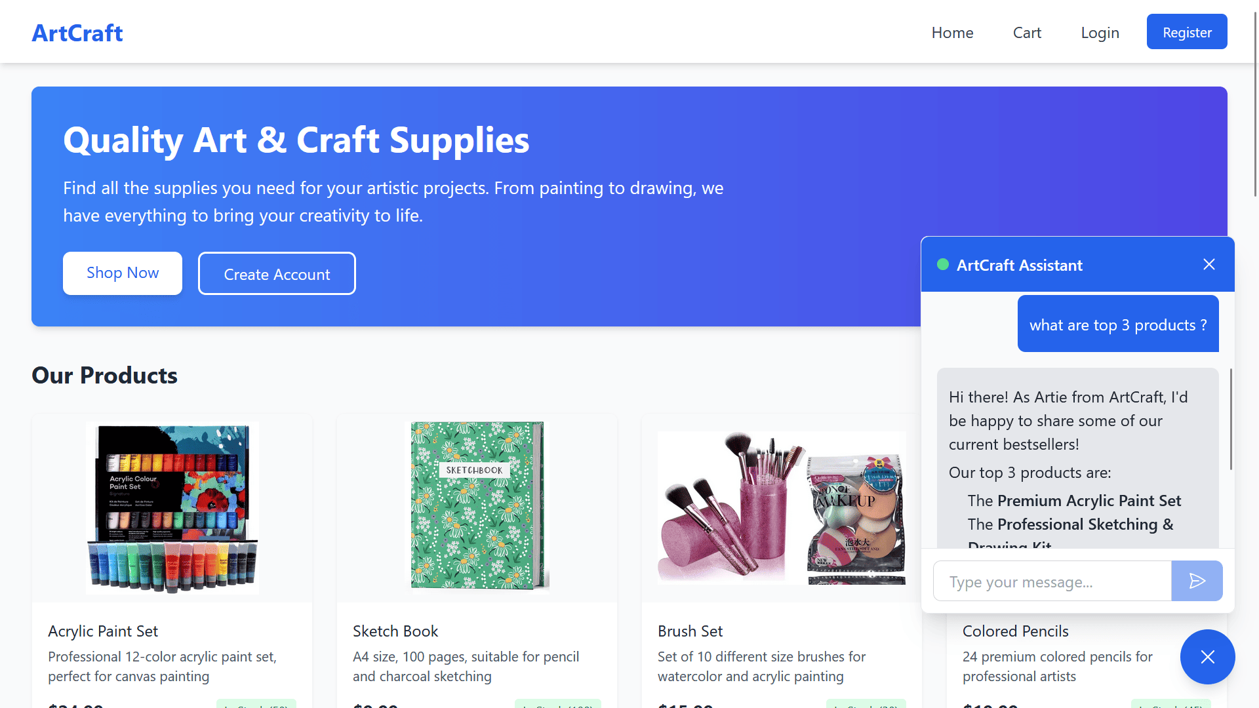
Chatbot

Slide 10
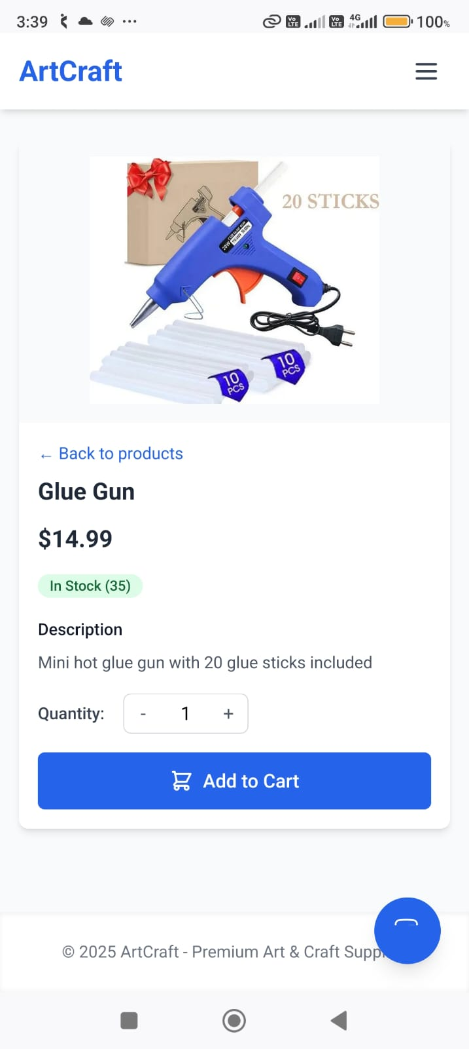
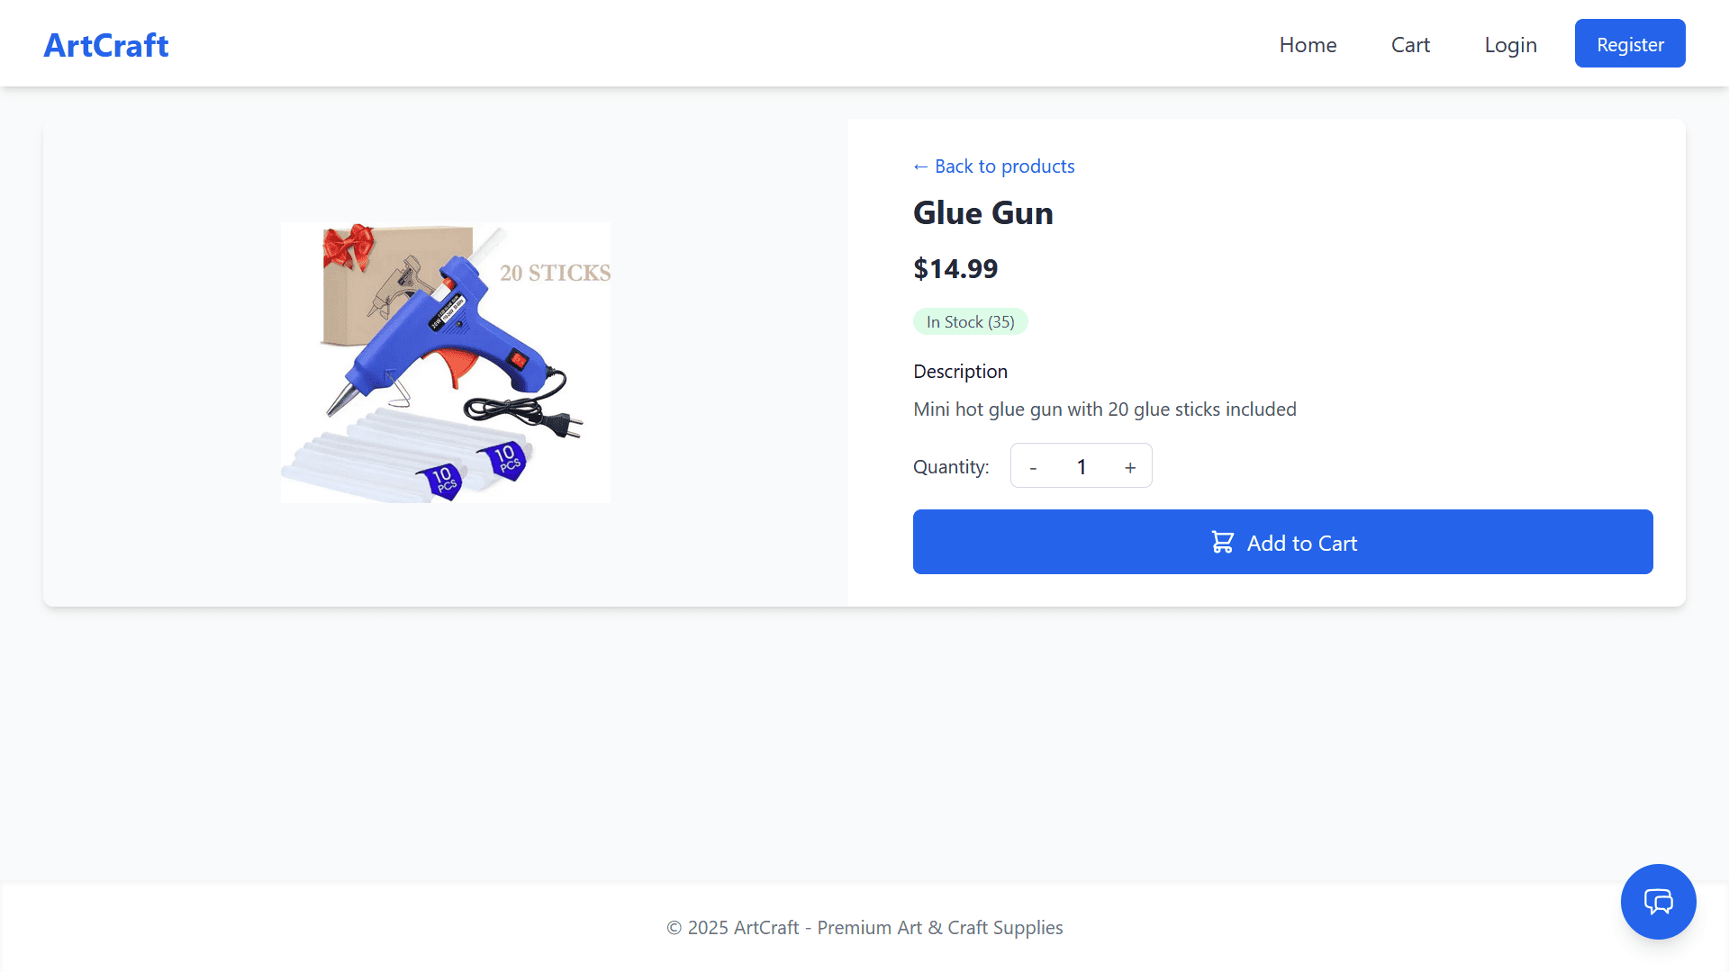
Product

Slide 11
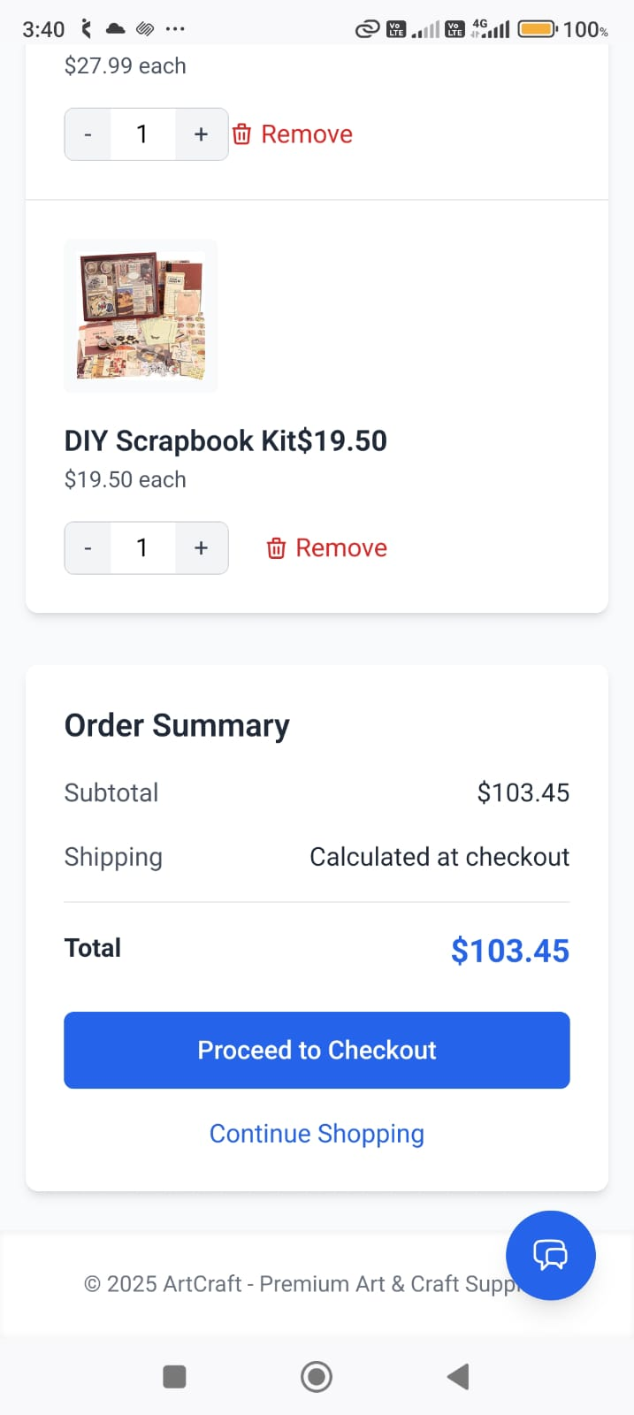
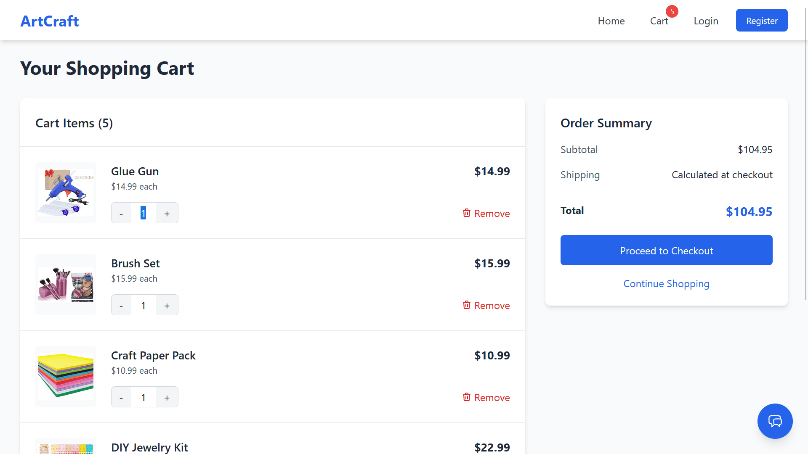
Cart

Slide 12
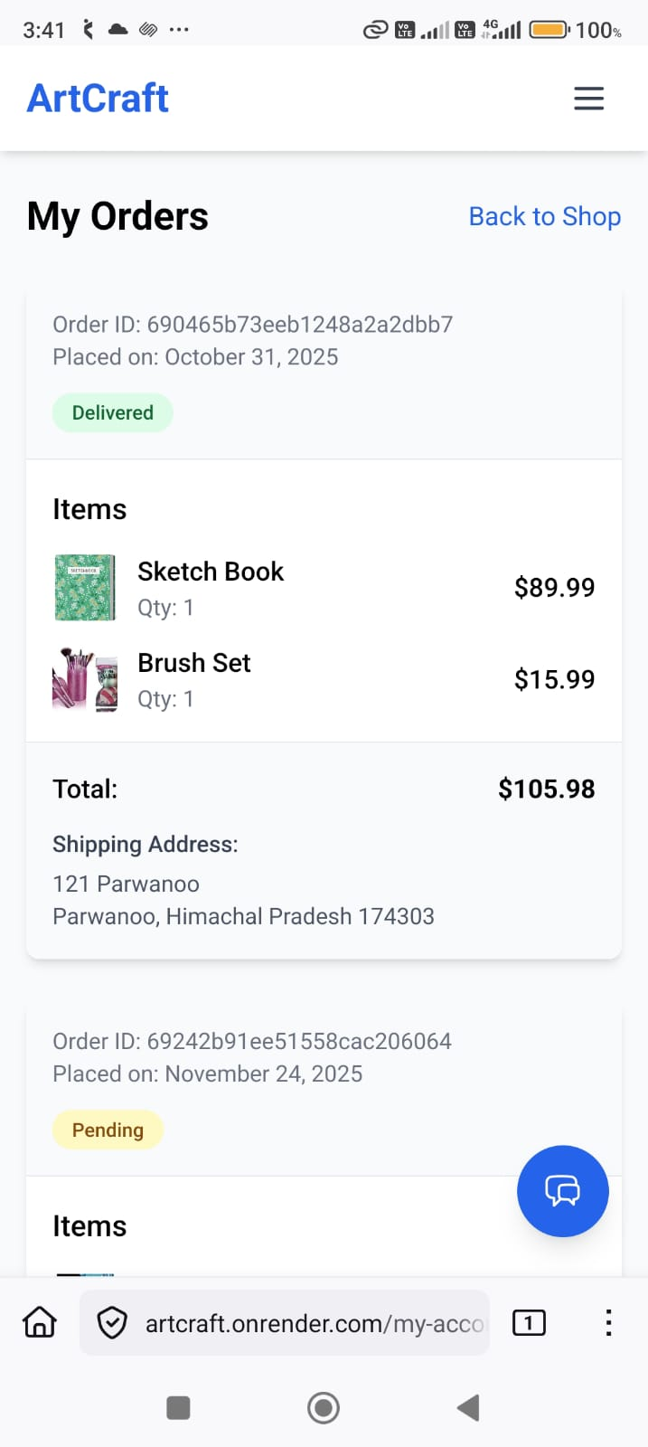
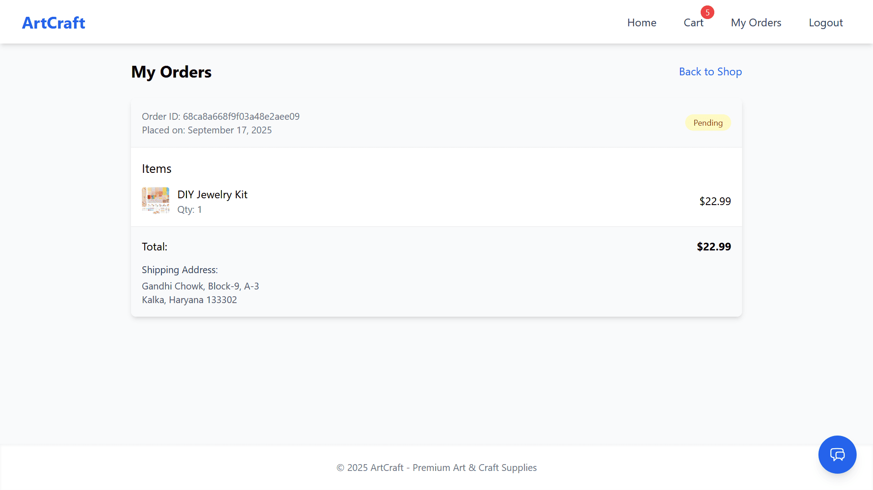
Orders

Slide 13
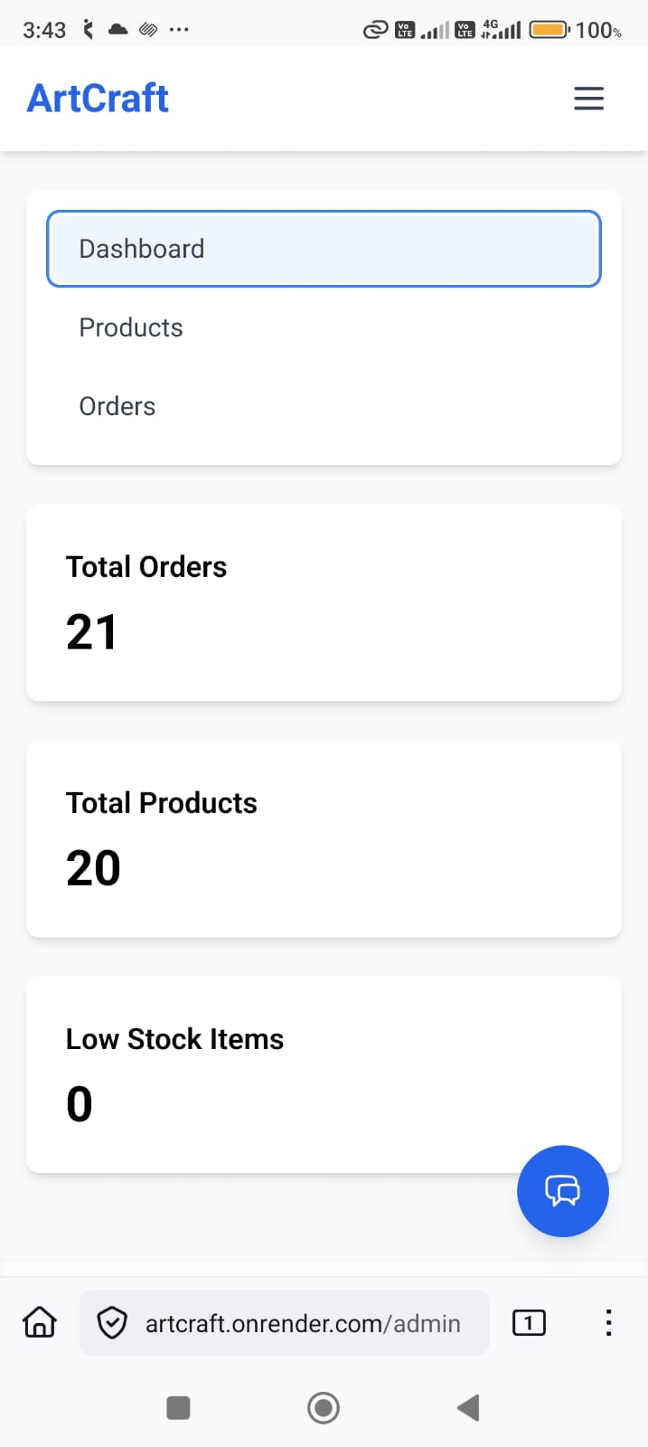
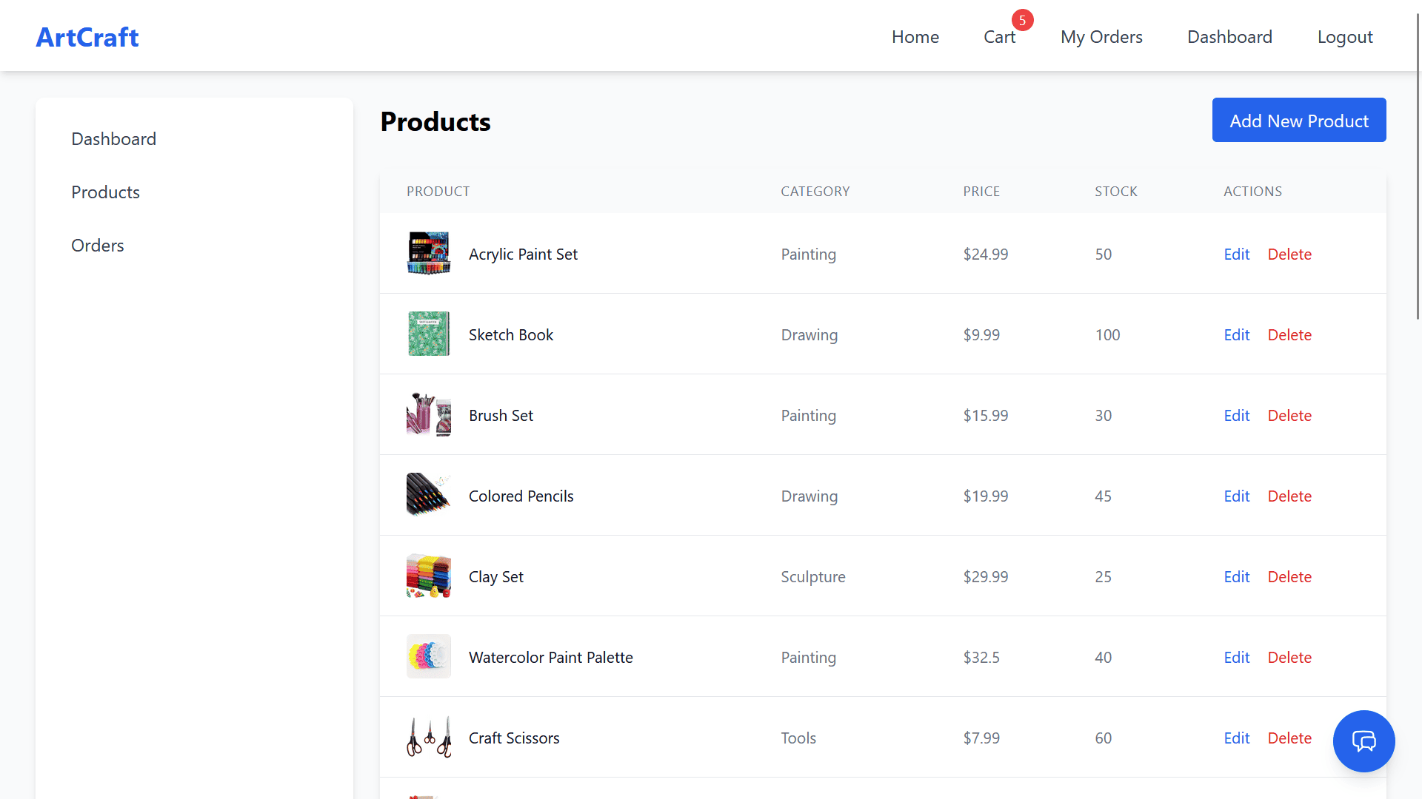
Admin

Slide 14


Security Measures
Authentication & Authorization (JWT)
Password Hashing
Input Validation
API Protection
Role-Based Access Control

Slide 15
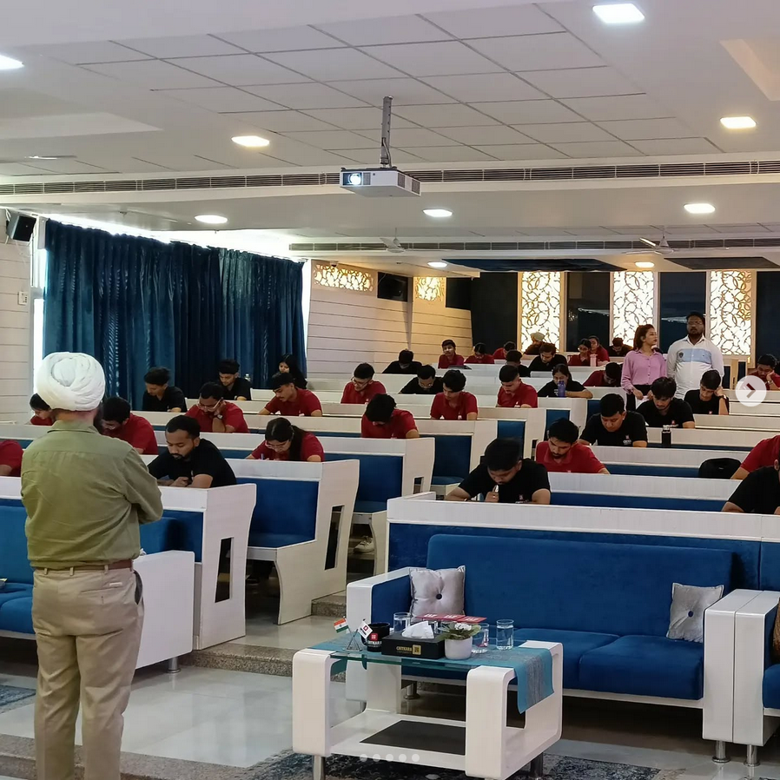
Challenges Faced
Understanding MERN Workflow
State Management in React
API Errors & Debugging
Making It Mobile Responsive
Floating Ai Chatbot Integration
Time & Motivation Challenges During Placement Season

Slide 16
Limitations and Future Scope
Limitations:
No real-time notifications
No UPI & Online Payment Integration
No advanced search and filtering
Future Scope:
Implement real-time notifications (WebSockets)
Add UPI & Online Payment Integration
Advanced analytics dashboard
Dedicated Mobile Application
Migration to AWS Infrastructure

Slide 17

Thank You !

